Slide 1

PROJECT BASED LEARNING
Employees evaluation for the Promotion’s

Slide 2
Description
Employees evaluation for the Promotion in HR department The HR team stored data of promotion cycle last year, which consists of details of all the employees in the company working last year and also if they got promoted or not, but every time this process gets delayed due to so many details available for each employee - it gets difficult to compare and decide. So this time HR team wants to utilize the stored data to make a model, that will predict if a person is eligible for promotion or not. Need to come up with a model that will help the HR team to predict if a person is eligible for promotion or not.

Slide 3
objective
1 | 2 | 3 | 4
Explore and visualize the dataset | Build a classification model to predict if the customer has a higher probability of getting a promotion | Optimize the model using appropriate techniques | Generate a set of insights and recommendations that will help the company

Slide 4
Library
→import numpy as np →import pandas as pd
→import seaborn as sns →import matplotlib.pyplot as plt
→from sklearn.metrics import classification_report
→from sklearn.model_selection import train_test_spilt
→from sklearn.preprocessing import LabelEncoder​
→from sklearn.preprocessing import StandardScaler​
→from sklearn import tree​
→import warnings​
→warnings.filterwarnings('ignore’)​ from sklearn.naive_bayes import GaussianNB​
→from sklearn import metrics​

Slide 5
CLASSIFICATION
Data is separated into different labels (or categories) according to the given input data.

Slide 6
Linear Models
Logistic Regression
Support Vector Machines
Non-linear Models
K-Nearest Neighbours
Kernel SVM
Naïve Bayes
Decision Tree Classification
Random Forest Classification

Slide 7
KNN (K-NEAREST NEIGHBOURS): THE DISTANCE FROM KNOWN DATA POINT
AFTER WE GATHER THE K NEIGHBOURS WE SIMPLEY TAKE THE MAJORITY AND CLASSIFY THE UNKNOWN DATA INTO THAT CATEGORY
LOGISTIC REGRESSION:THIS FUNCTION IS ALSO CALLED THE SIGMOD FUNCTION. INPUT VALUES ARE COMBINED LINEARLY USING WEIGHTS OR COEFFIECT VALUES TO PREDICT AN OUTPUT .IT IS DIFFERNET FROM LINEAR REGRESSION BECAUSE THE OUTPUT VALUVE BEING MODELLED IS BINARY INSTEAD OF CONTIUOUS
NAÏVE BAYES: IT WORKS ON THE BAYES’THEOREM
BAYES’ THEOREM FIND THE PROBABLILITY OF AN EVENT OCCURING GIVEN THE PROBABILITY OF ANOTHER EVENT THAT HAS ALREADY OCCURRED IT IS CALL ED NAÏVE BAYES OR IDIOT BAYES
BECAUSE THE CALCULATION OF THE PROBABILITIES FOR EACH HYPOTHESIS ARE SIMPLIFIED TO MAKE OWN CALCULATION
SUPPORT VECTOR MACHINE:SVM IS AN EXCITING ALOGORTHM AND THE CONCEPTS ARE RELATIVELY SIMPLE THE MAXIMAL –MARGIN CLASSSIFIER IS A HYPOTHETICAL CLASSIFIER THAT BEST EXPLAINS HOW SVM WORK IN PRACTICE
IN SVM A HYPLANE IS SELECTED TO BEST SEPARATE THE POINTS IN THE INPUT VARIABLE SPACE BY THEAI CLASS
IN TWO DIMENSIONS YOU CAN VISUALIZE THIS AS A LINE AND IN THREE DIMENSIONS IT CAN BE A HYPER PLANE

Slide 8
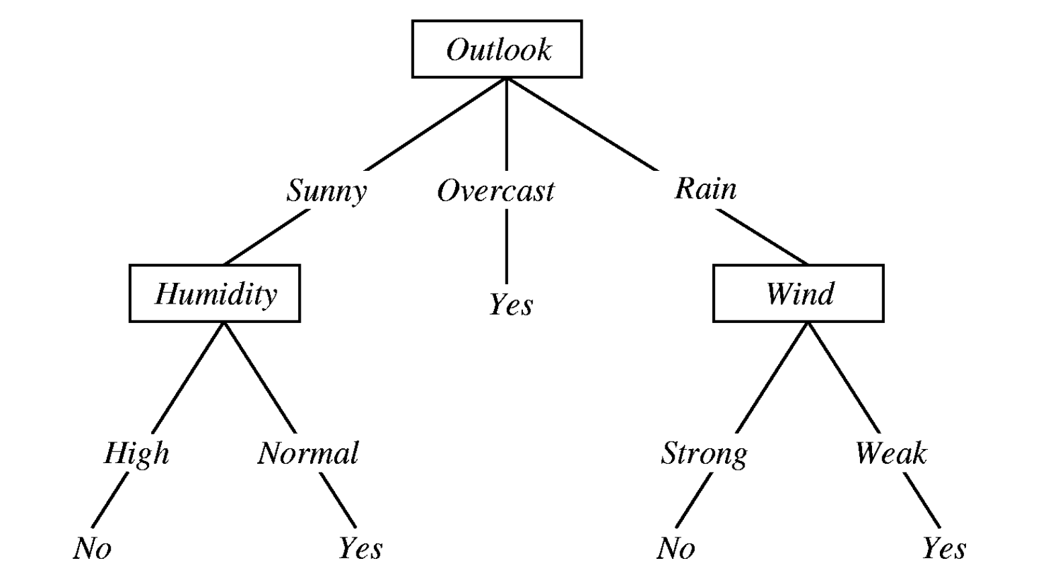
RANDOM FOREST: IT USES A LOT OF DECISION TREES SAY,AN ENSEMBLE WHERE EACH TREE IS LITTLE DIFFERENT FROM THE OTHERS WHEN WE GET A NEW DATA,WE TAKE THE MAJORITY VOTE OF THE ENSEMBLE TO GET A FINAL RESULT
DECISION TREE:

Slide 9
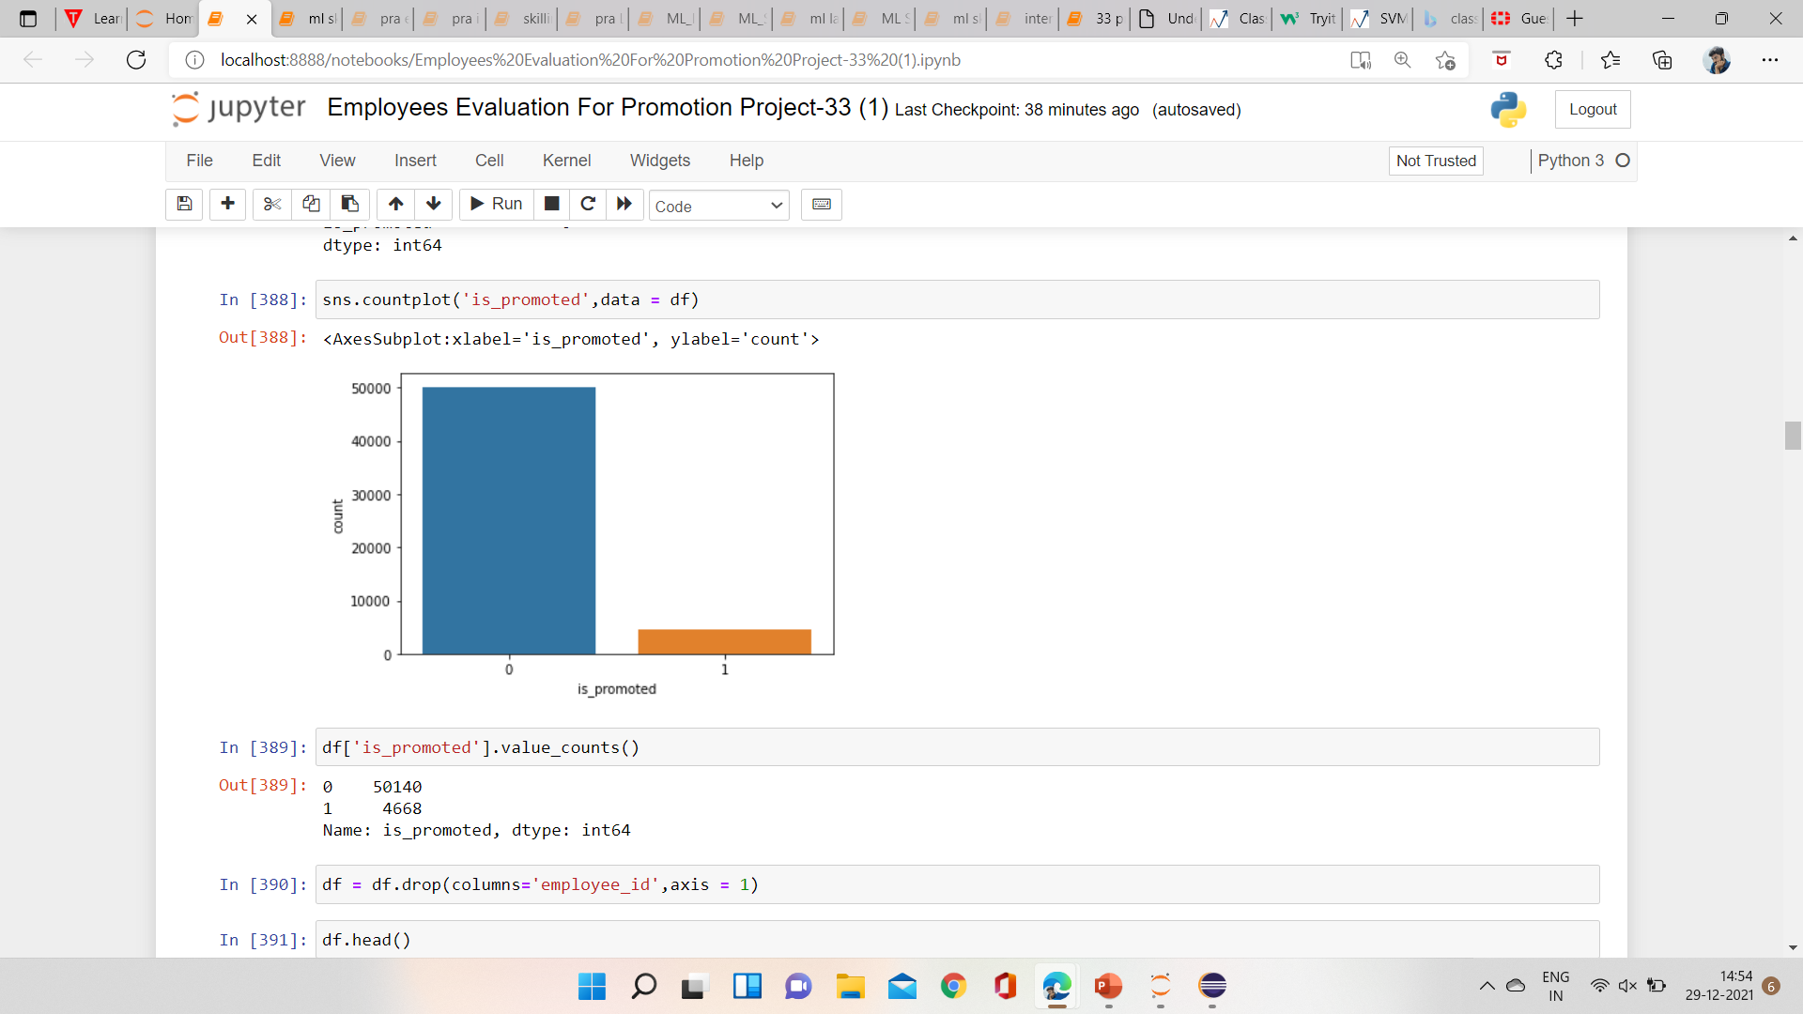


Slide 10
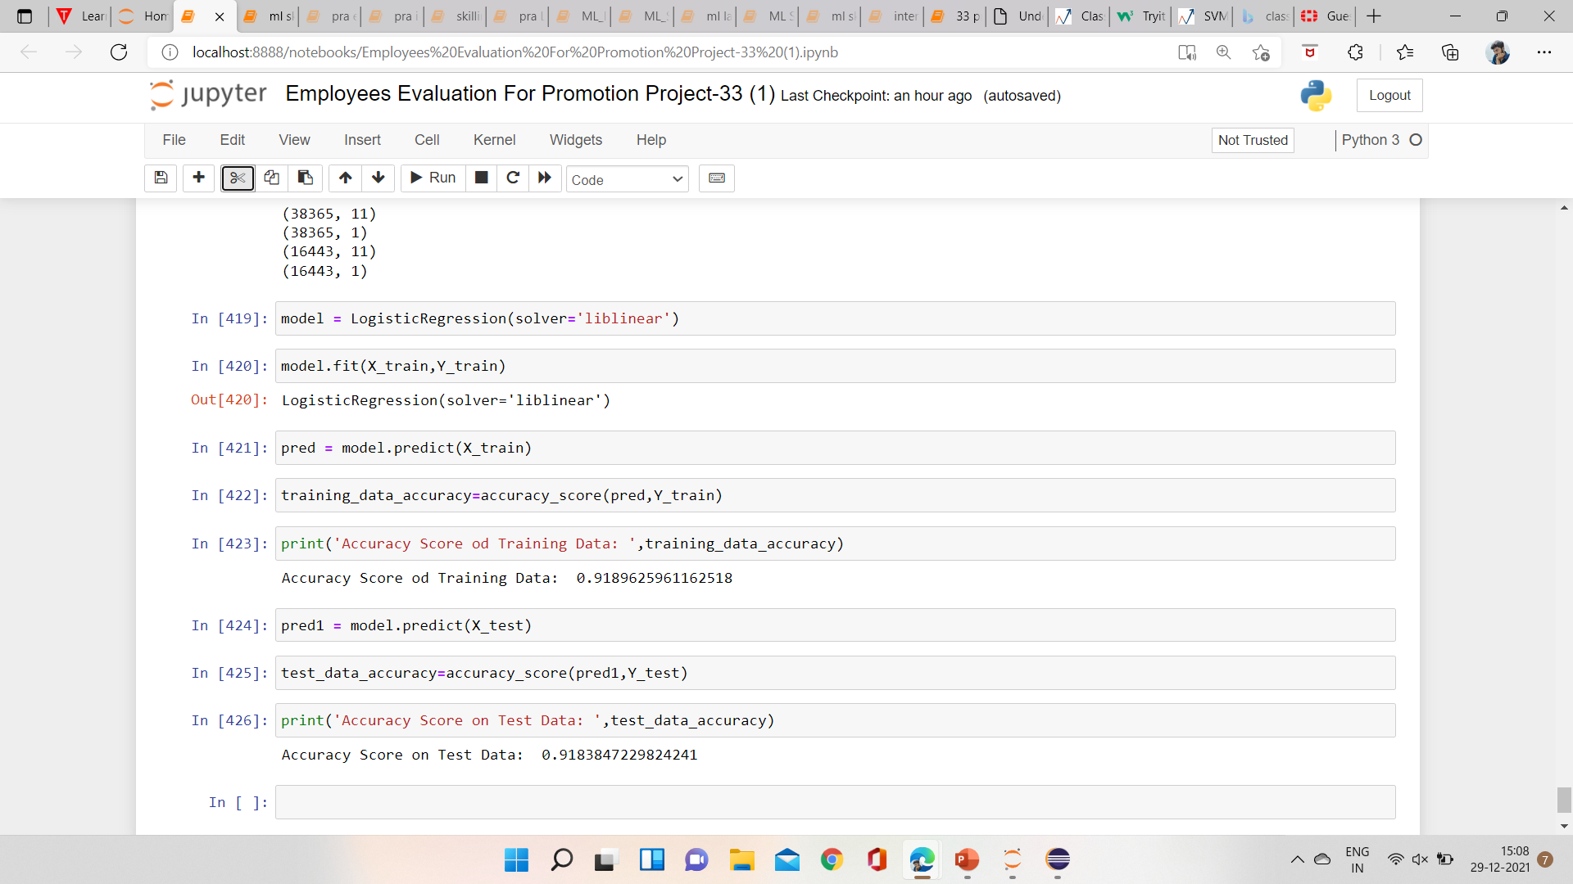

Slide 11


